Slide 1

Resolution proposition
Homework - Exercise 1.1

Slide 2
Problem statement
Exercise 1
Using general resolution prove that the following formulas are theorems.
1.

Slide 3
Chapters
Theory
Solution
Conclusion

Slide 4
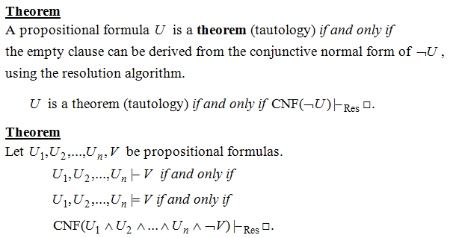
Theory aspects

Slide 5
Solution
We compute ¬ U (refutation method) in CNF
¬ U = ¬[(A → B ∧ C) → (A → B) ∧ (A → C)]
= ¬ [¬ (¬ A ∨ B ∧ C) ∨ (¬ A ∨ B) ∧ (¬ A ∨ C)]
= (¬ A ∨ B ∧ C) ∧ (A ∧ ¬B) ∨ (A ∧ ¬C)
= (¬ A ∨ B ∧ C) ∧ A ∧ (¬B ∨ ¬C)
= (¬ A ∨ B ) ∧ (¬ A ∨ C ) ∧ A ∧ (¬B ∨ ¬C)
CNF = (¬ A ∨ B ) ∧ (¬ A ∨ C ) ∧ A ∧ (¬B ∨ ¬C)
S = {¬ A ∨ B,¬ A ∨ C, A, ¬B ∨ ¬C}

Slide 6

□
□
The resolution rule is applied to all possible pairs of clauses that contain complementary literals. After each application of the resolution rule, the resulting sentence is simplified by removing repeated literals.
C1 = ¬ A ∨ B, C2 = ¬ A ∨ C, C3 = A, C4 = ¬B ∨ ¬C
C1 = ¬ A ∨ B
C3 = A
C2 = ¬ A ∨ C
C4 = ¬B ∨ ¬C
C5 = Res A (C1,C3) = B
C6 = Res C (C2,C4) = ¬ A ∨ ¬ B
C7 = Res B(C5,C6) = ¬ A
C3 = A
C8 = Res A(C7, C3) =

Slide 7
Conclusion
Because after applying the resolution rule the empty clause has been derived, the negated formula is unsatisfiable (or contradictory), and hence it can be concluded that the initial conjecture is a tautology.
Thank you for your attention!
Cibu Clara

